Slide 1
Mathematical Modelling
Level 10

Slide 2
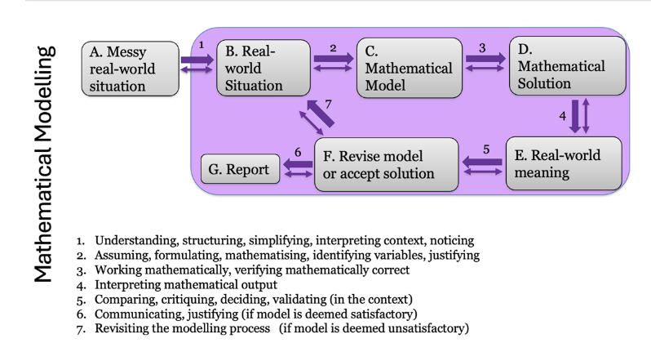
Mathematical Modelling Cycle

Slide 3
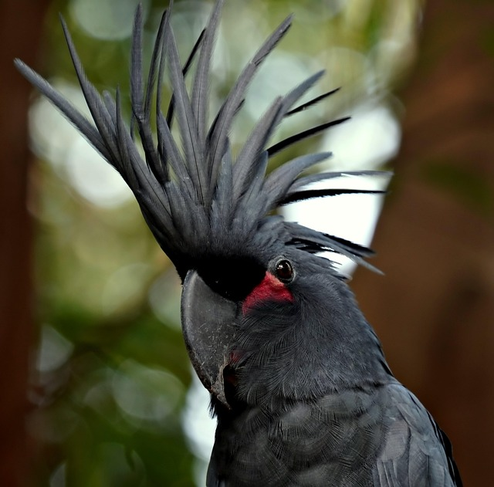
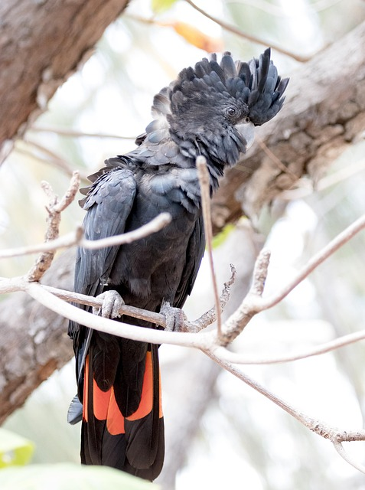
Have you seen this bird?
Notes:
https://pixabay.com/photos/black-cockatoo-animal-wildlife-8206566/
https://pixabay.com/photos/bird-cockatoo-wildlife-animal-3729275/

Slide 4
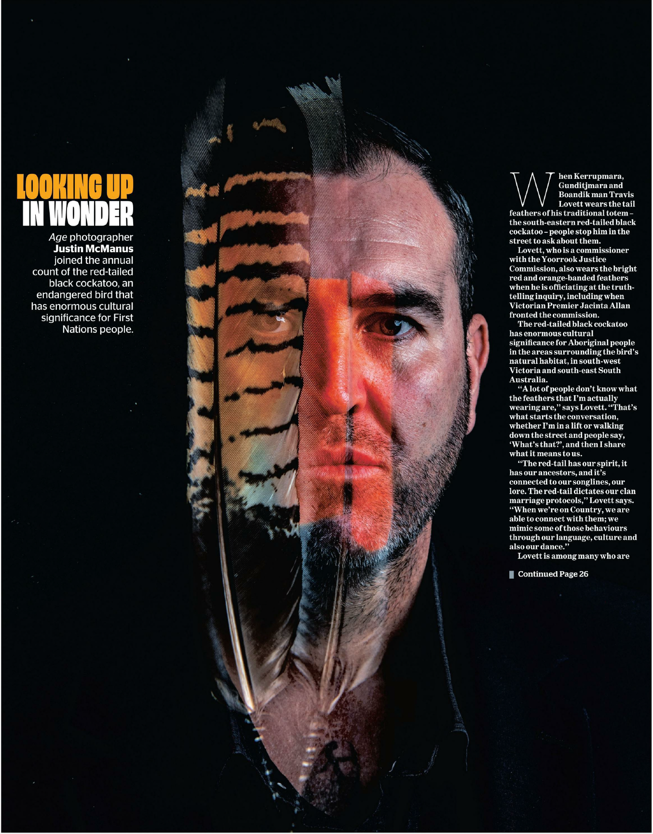
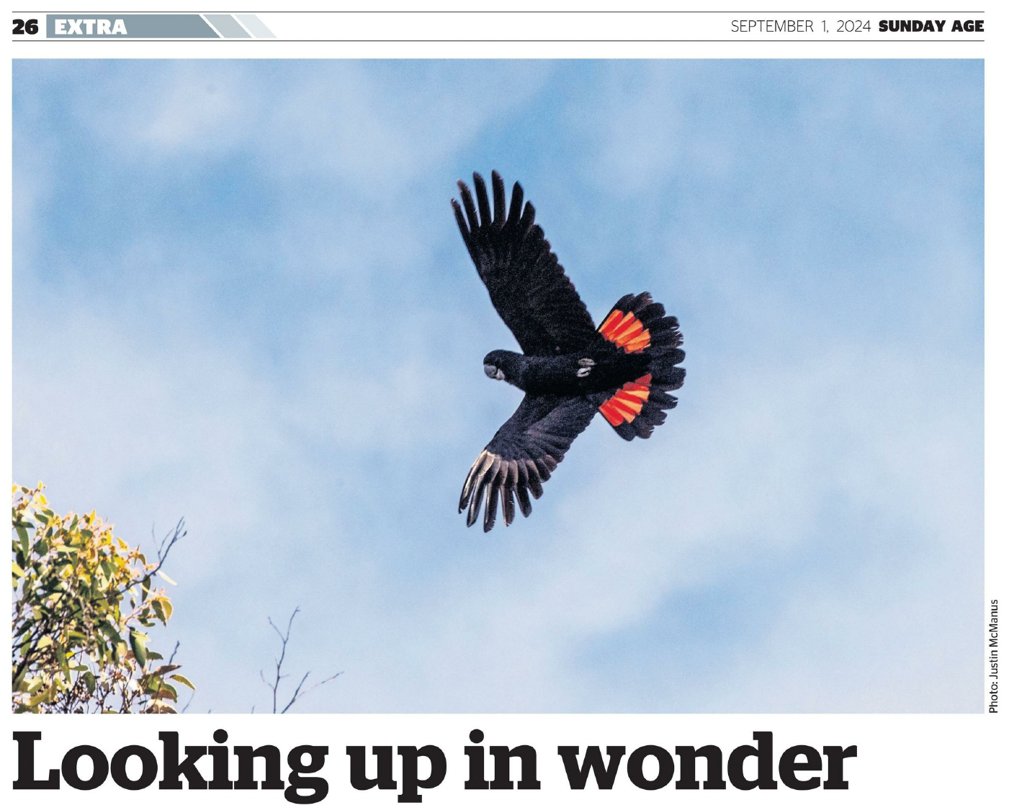
The Sunday Age September 1, 2024
Read parts of the article.
Try to get a sense of the messy real-world situation
What problems emerge in the article where mathematics might be used to help solve them?

Slide 5
Look up and Wonder
Reading about South-Eastern red-tailed black cockatoo (Calyptorhynchus banksii graptogyne).
What is the problem?
What is the significance of the RTBT to Travis Lovett?
Do all the birds look the same? [irrespective of gender or age?]
In the photograph on page 27, how many birds can you count?
Of these how many are male| barred| unable to be determine?
What are the current numbers?
What do we know about their eating habits?
What factors are contributing to the endangering of the RTBC?
How many birds were counted in 2024? 2023, and 2015?
Why does one part of the article suggest 1000-1500 RTBC and another part exact values?

Slide 6
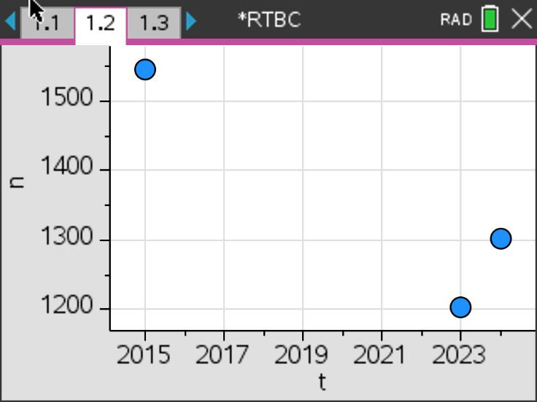
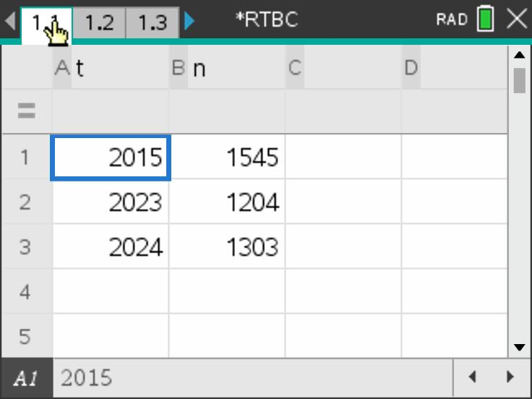
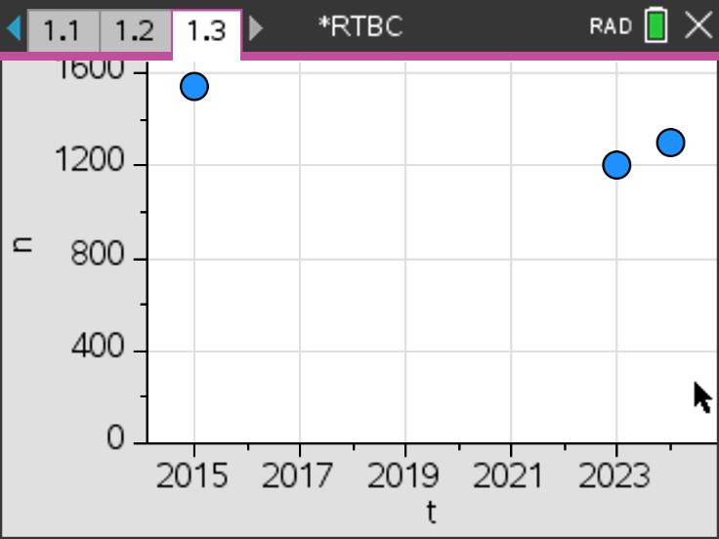
Looking at the data
How useful is this data?
The two plots have differing viewing ranges, what are these and how do the two plots differ in what we might notice?

Slide 7
Red-Tailed Black Cockatoo (RTBC) data 2012-2024
Year | No. of RTBC
2012 | 404
2013 | 1118
2014 | 1064
2015 | 1545
2016 | 901
2017 | 810
2018 | 839
2019 | 1193
2020 | 1144
2021 | 1230
2022 | 1143
2023 | 1204
2024 | 1303
Here is the data reported from the annual count.
Note that in 2022, the count was restricted to 'look the skies'.
Other information is collected included the weather on the day of the count, the number of flocks

